Slide 1

Blossom Bank
Online Fraud Prediction Using Machine Learning
Segun Umoru

Slide 2




Infographic Style
Executive Summary
About
Blossom Bank also known as BB PLC is a multinational financial services group, that offers retail and investment banking, pension management, asset management and payments services, headquartered in London, UK.
01
Problem Statement
02
Blossom Bank wants to build a Machine Learning model to predict online payment fraud.
Exploratory Data Analysis
Insights and visualization was done using the concept of Univariate Analysis, Bivariate Analysis and Multivariate Analysis after wrangling the data.
03
Summary and Recommendation
04
Recommendation is based on the ML models used to train the data set and feature engineering and classification for accurate prediction.

Slide 3
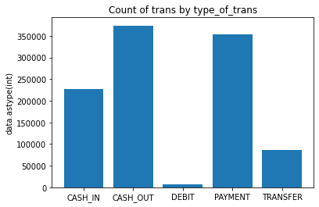
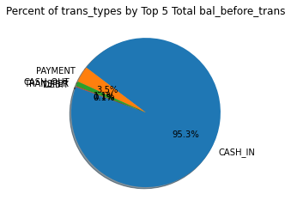
1
Exploratory Data Analysis:
Insights and Visualizations.
Insights are generated through exploratory Data Analysis done to help the stakeholders of the bank make informed business decision to increase revenue.
Here are five transaction types the bank use as payment type. They are; PAYMENT, TRANSFER, CASH OUT, DEBIT, CASH IN, CASH OUT was the most conducted transaction type and generated the highest number of transactions
1
2
2
Based on the percentage of Transaction types by Top five Total Balance before transaction. The CASH IN payment type was the most conducted transaction type with the highest sum of total balance before transaction was carried on the account.

Slide 4
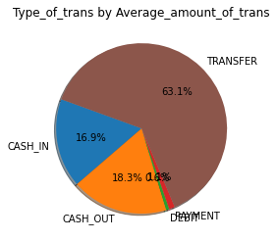
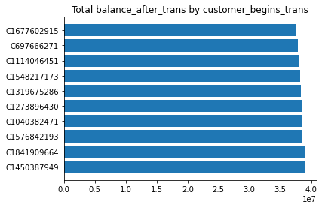
3
Exploratory Data Analysis:
Insights and Visualizations.
Insights are generated through exploratory Data Analysis done to help the stakeholders of the bank make informed business decision to increase revenue.
TRANSFER was the most conducted transaction payment type and generated the highest average of transactions amount 63.1% for the bank. This shows that people do more of online transfer type of payment to recipients.
3
4
4
Horizontal bar chart was used to visualize top 10 customers by Total balance after Transaction was done.
It was observed that the Customer with the customer ID - C1450387949 has the highest Total Balance after Transaction completed with the bank while customer with the customer ID - C2104815114 has the lowest balance .

Slide 5
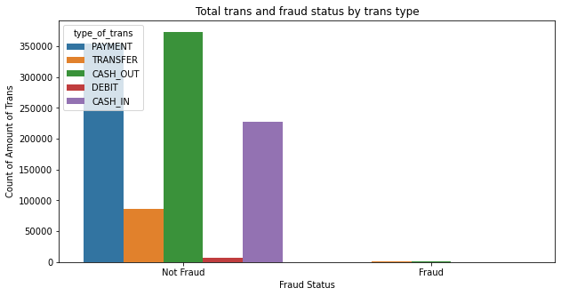
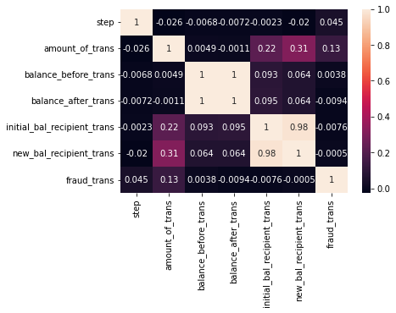
5
Exploratory Data Analysis:
Insights and Visualizations.
Insights are generated through exploratory Data Analysis done to help the stakeholders of the bank make informed business decision to increase revenue.
Based on Fraud status, it is observed that Cash_Out payment type of transaction is Not Fraud though generated the highest number of transactions done in the Bank.
5
6
6
Correlation analysis was done to show the relationships between variables(features) and how close they are to either 0 or 1. We can see that balance before and balance after transactions is 1, that gives a likelihood of fraud compare to others.

Slide 6
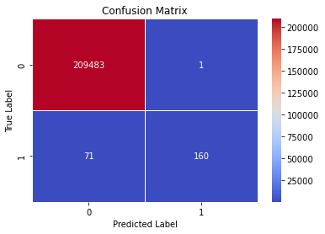

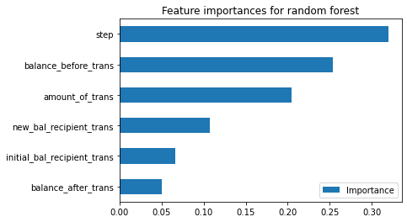


4
1
A heatmap, show that fraud predicted
transactions using a Random Forest model has 99.965% accuracy with 71 truly fraud(TP) despite
FN = 209483 labelled to be True, TN = 160 are predicted to be fraud but FP = 1 is Not fraud .
Features Engineering and Confusion Matrix
A heatmap, show that fraud predicted
transactions using a logistic regression model has 99.9% accuracy with 152 truly fraud despite
FN = 209427 out of 79 predicted to be Fraud but 57 is Not fraud.
Feature importance shows how much each features or variables will contribute to the model prediction, and we can see that step has a larger relevance followed by balance before transaction in that order.
Confusion matrix shows the performance of a classification model on a given set for which true values are known.
3
2
A heatmap, show that fraud predicted
transactions using a Decision tree model has 99.965% accuracy with 51 truly fraud(TP) despite
FN = 209448 labelled to be True, TN = 180 are predicted to be fraud but FP = 36 is Not fraud .
A heatmap, shows that fraud predicted
transactions using a Decision K-neighbors Classifier model has 99.994% accuracy with 109 truly fraud(TP) despite FN = 209464 labelled to be True, TN = 122 are predicted to be fraud but FP = 20 is Not fraud .

Slide 7
Recommendations
I will suggest the
Bank hire a data
engineer that will
ensure the dataset is
accurate, large and
Clean for proper EDA
as their too many
outliers in the dataset This will enable the
business to produce machine learning
models that
predict outcomes
more accurately with better performance.
The CASH_OUT type of transaction
reported high fraud
despite having a
lower revenue
Impact. I will suggest that a cash regulation should be introduce to mitigate regular cash out. Individual should be allow to
withdraw a certain
amount from their
account per day.
The CASH_OUT type of
transaction reported high fraud despite having a
lower revenue
Impact. I will suggest
that a cash regulation
should be introduce to
mitigate regular cash out.
Individual should be allow to withdraw a certain
amount of cash from their
account per day.
I will suggest that the bank should invest in their workers through EdTech platforms so that they can stay inform on new technologies in knowing how to mitigate fraud within their system through industry best practices

Slide 8

About Me
I am a graduate of Mathematics with a flair for Data Analysis, AI and Machine Learning. My areas of expertise are in data analysis and visualization, data modeling, machine learning and analytics dashboard reporting. I am fast in learning new technical tools and picking up new skills.
I currently have experience with the use of GitHub, Excel, Power-BI, and Python libraries like Pandas, Numpy, Matplotlib, Seaborn, and Scikit-Learn.
Here are the links to my Analytics Dashboard Reports, Exploratory Data Analysis and Machine Learning portfolio:
Dashboard Portfolio
GitHub Repository
I have participated in two Data fellowship in the area of Data Analytics and Data Science, currently planning to do a Master degree in Data Science and have completed a series of online certifications in Python, Data visualization with Power-BI, etc. Kindly check out my LinkedIn profile here. I am open to opportunity in Data Analytics and Data Science in the Fintech Industry. You can as well check out my articles on medium as I also derive pleasure educating people for want to dive into Data Science and Machine Learning.
Segun Umoru

